Slide 1

Ensemble Models and Kernel-based Methods
Payam Barnaghi
Department of Brain Sciences &
School of Convergence Science (Human and Artificial Intelligence)
Imperial College London
January 2026
Notes:
1

Slide 2
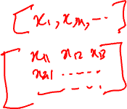
Feature Vectors
So far, we have assumed that each item we wish to classify, cluster, or process can be represented as a fixed-size feature vector.
However, for certain types of items/concepts, it is not clear how to best represent them as fixed-sized feature vectors.
For example, how do we represent a text document or protein sequence, which can be of variable length? Or a molecular structure, which has a complex 3d geometry? or an evolutionary tree, which has variable size and shape?

Slide 3
Kernel functions
One approach to the latter problem is to assume that we have a way to measure the similarity between items that doesn’t require preprocessing them into a feature vector.
For example, we can apply a function to transform the original data into a higher-dimensional space in which the data items can then be compared/processed.
This process can be done via kernel functions.

Slide 4
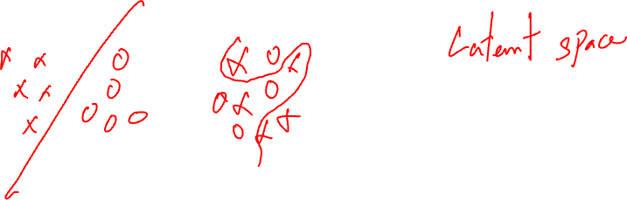
Linear separability
We have also often assumed that the data items are linearly separable, but what if the data were not linearly separable?
In this case, we can again apply a kernel that maps each data instance (from the original non-linear observation space) into a higher-dimensional space where the data instances become separable.

Slide 5
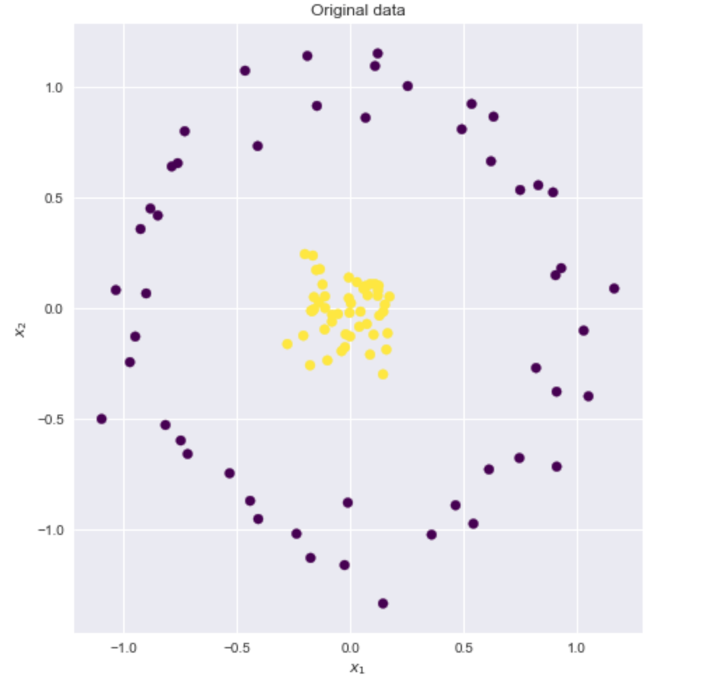
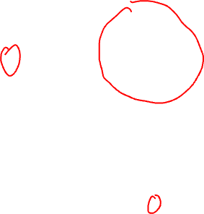
Example
Source: https://xavierbourretsicotte.github.io/Kernel_feature_map.html

Slide 6
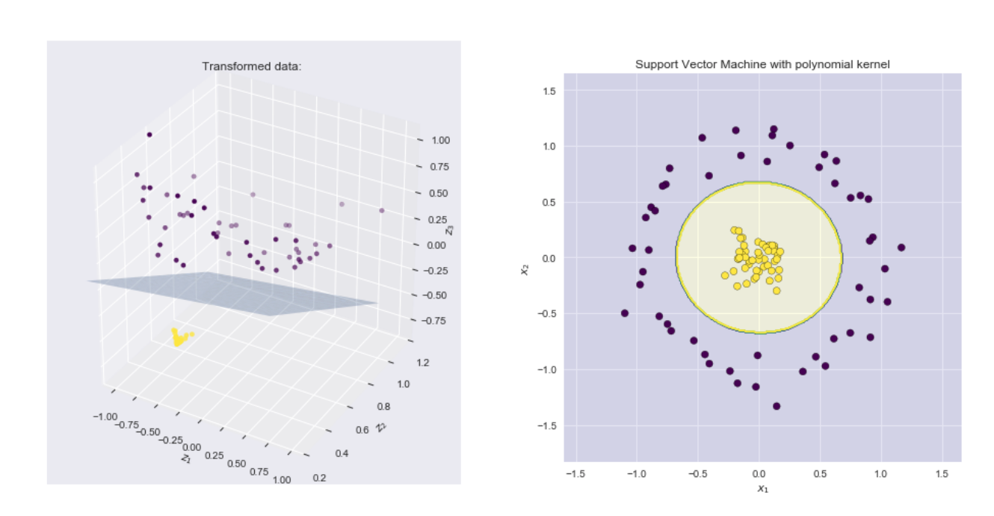
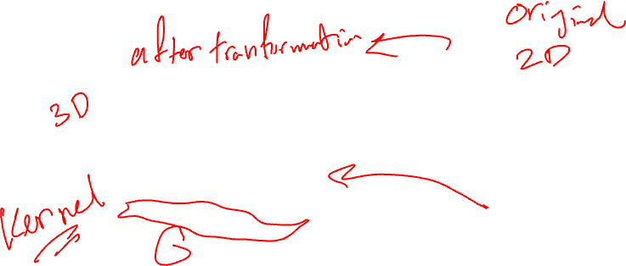
Example – applying polynomial kernel
Source: https://xavierbourretsicotte.github.io/Kernel_feature_map.html

Slide 7
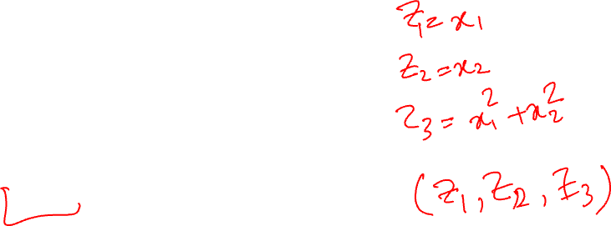
What is a polynomial kernel?
If our data is a set of (x₁, x₂)
Transform it to (z₁,z₂,z₃) in which:
z₁ = x₁
z₂ = x₂
z₃ = x₁² + x₂²
(z1,z2,z3)= (x₁, x₂, x₁² + x₂²)
This is, in fact, the sum of polynomials

Slide 8
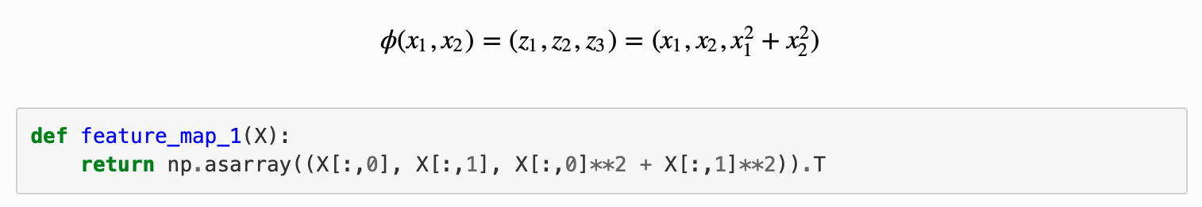
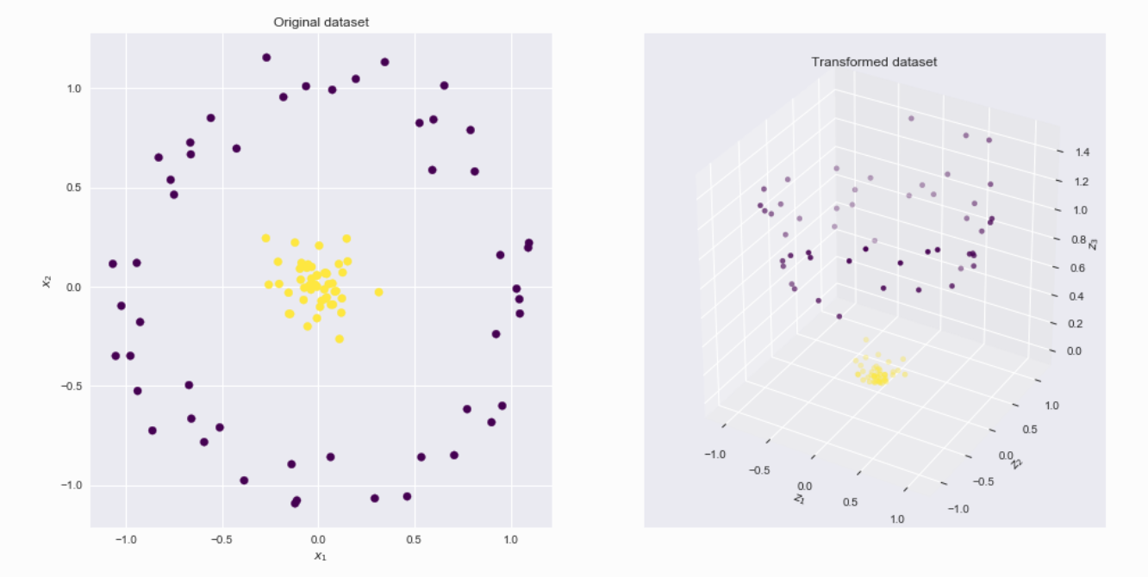
A polynomial kernel
Source: https://xavierbourretsicotte.github.io/Kernel_feature_map.html

Slide 9
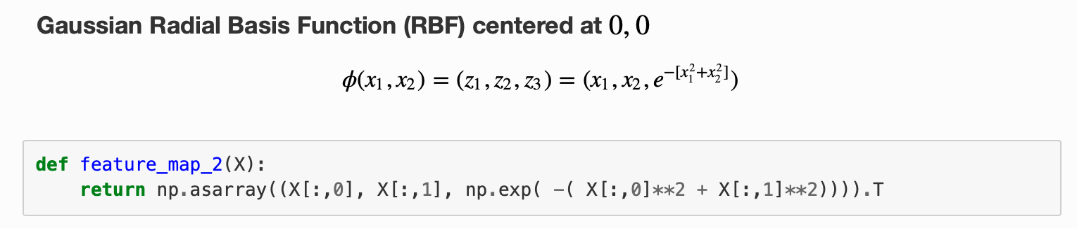
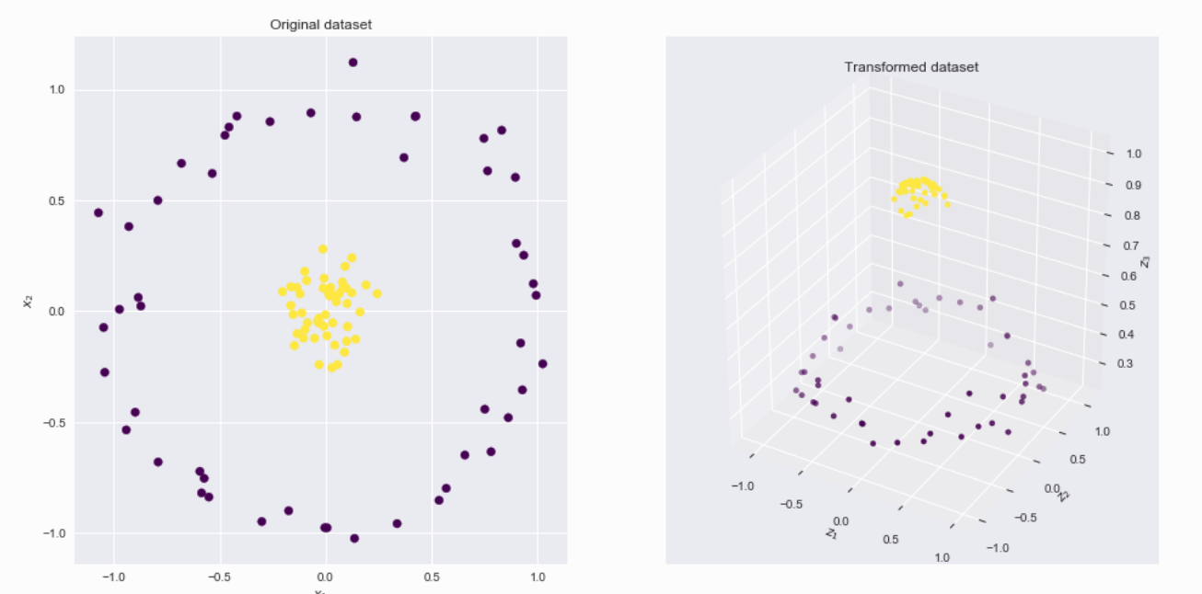

Gaussian Radial Basis Function (RBF)
Source: https://xavierbourretsicotte.github.io/Kernel_feature_map.html

Slide 10
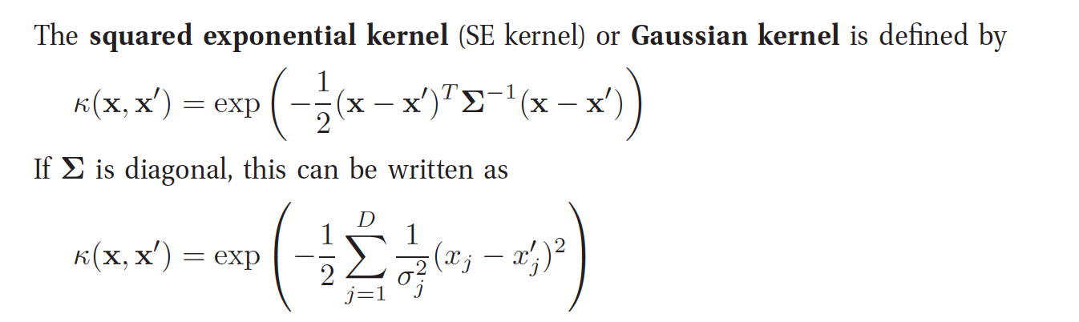
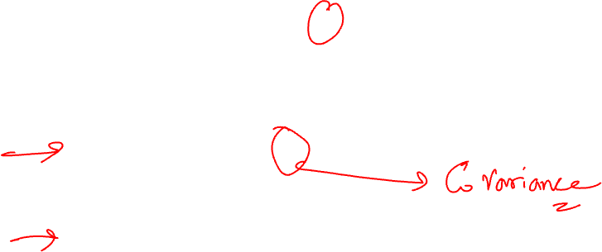
RBF Kernel in more generalised form*
Source: Kevin Murphy, Machine Learning: A probabilistic Approach, MIT Press.

Slide 11
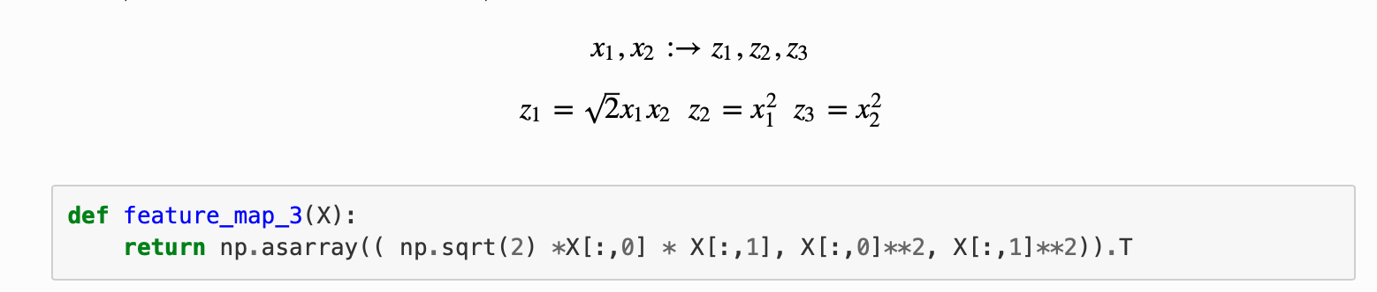
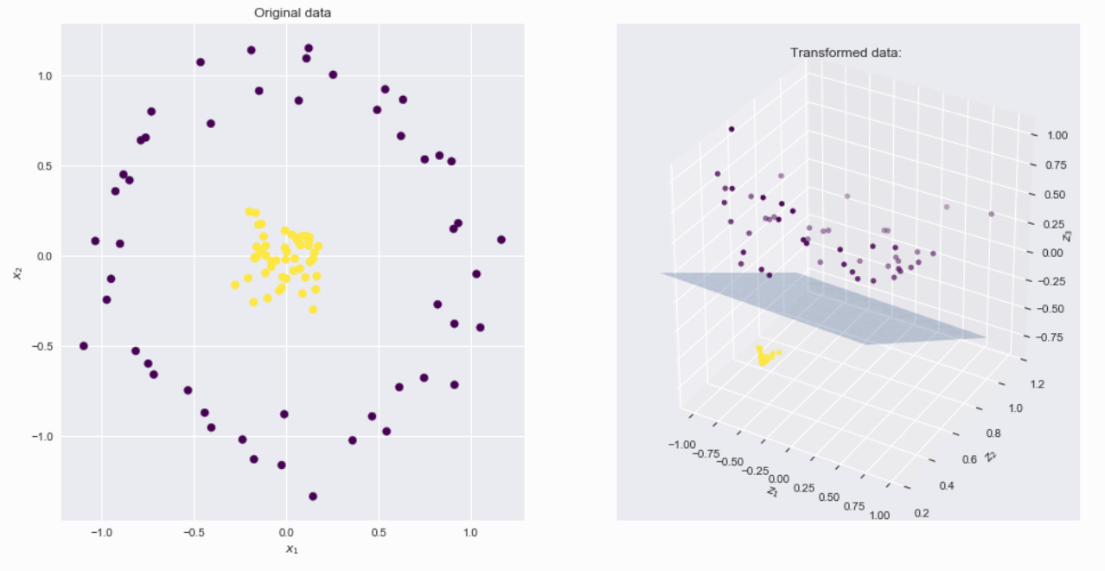
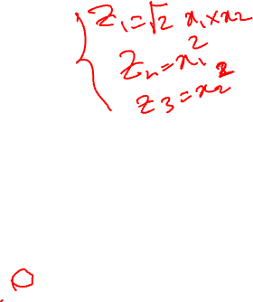
Another polynomial function
Source: https://xavierbourretsicotte.github.io/Kernel_feature_map.html

Slide 12
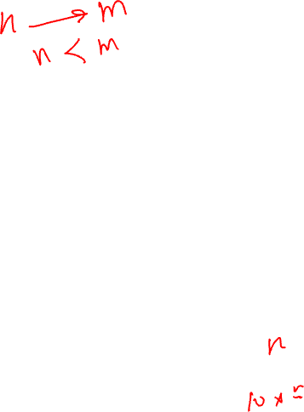
Support Vector Machines
Support vector machines (SVMs) are a set of supervised learning methods used for classification, regression and outlier detection.
The advantages of support vector machines are:
Effective in high-dimensional spaces.
It could still be effective in cases where the number of dimensions is greater than the number of samples.
It uses a subset of training points in the decision function (called support vectors), making it also memory-efficient.
Versatile: Different kernel functions can be specified for the decision function. Common kernels are provided, but it is also possible to define custom kernels.
Source: Scikit learn documentation

Slide 13
SVM - disadvantages
The disadvantages of support vector machines include:
If the number of features exceeds the number of samples, the method will likely give poor performance.
SVMs do not directly provide probability estimates.

Slide 14
SVM Classifier
A Support Vector Machine (SVM) is a discriminative classifier formally defined by a separating hyperplane.
In other words, given labelled training data (supervised learning), the algorithm outputs an optimal hyperplane which categorises new examples.
e.g., For a linearly separable set of 2D-points which belong to one of two classes, find a separating straight line.

Slide 15
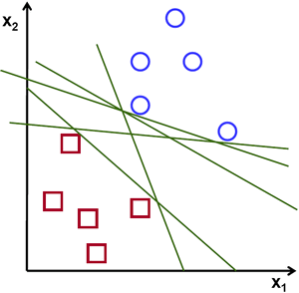
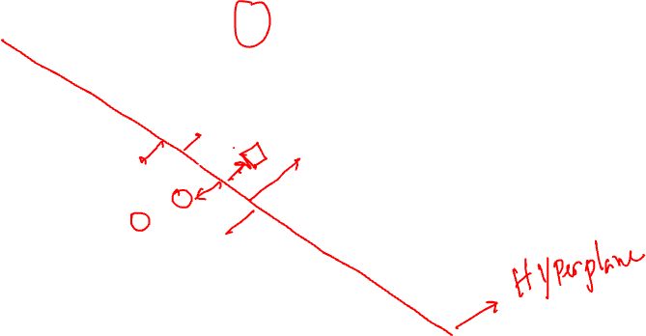
SVM Example
Source: https://vovkos.github.io/doxyrest-showcase/opencv/sphinx_rtd_theme/page_tutorial_introduction_to_svm.html

Slide 16
Linear separation
In this example, we deal with lines and points in the Cartesian plane instead of hyperplanes and vectors in a high-dimensional space.
This is a simplification of the problem.
It is important to understand that this is done only because our intuition is better built from easily imagined examples.
However, the same concepts apply to tasks where the examples to classify lie in a space whose dimension is higher than two.
Source: https://vovkos.github.io/doxyrest-showcase/opencv/sphinx_rtd_theme/page_tutorial_introduction_to_svm.html

Slide 17
SVM – linear separation
We can intuitively define a criterion to estimate the worth of the lines:
A line is bad if it passes too close to the points because it will be noise-sensitive and will not generalise correctly. Therefore, our goal should be to find the line passing as far as possible from all points.
Then, the SVM algorithm operates by finding the hyperplane that maximises the minimum distance to the training examples.
This distance is given the important name of the margin in SVM. Therefore, the optimal separating hyperplane maximises the margin of the training data.
Source: https://vovkos.github.io/doxyrest-showcase/opencv/sphinx_rtd_theme/page_tutorial_introduction_to_svm.html

Slide 18

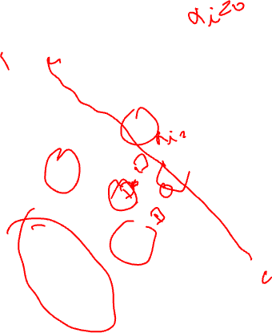
Example: SVM for a linearly separable set of 2d-points
Source: https://vovkos.github.io/doxyrest-showcase/opencv/sphinx_rtd_theme/page_tutorial_introduction_to_svm.html

Slide 19
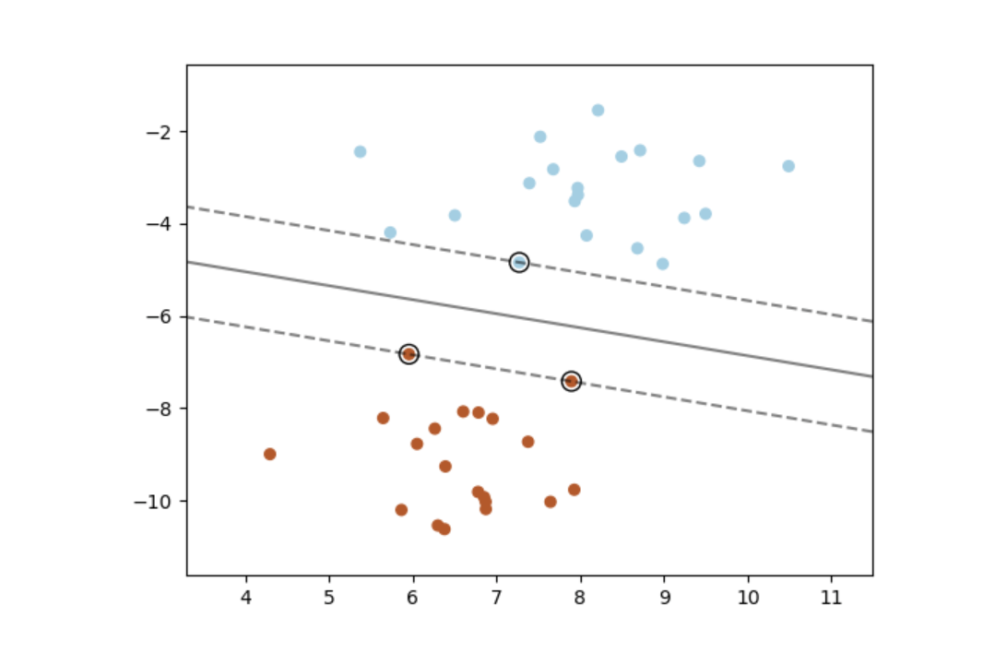
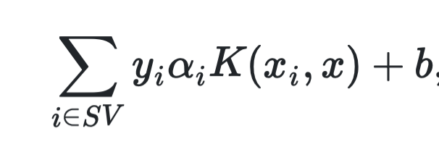
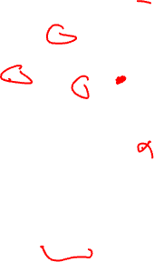
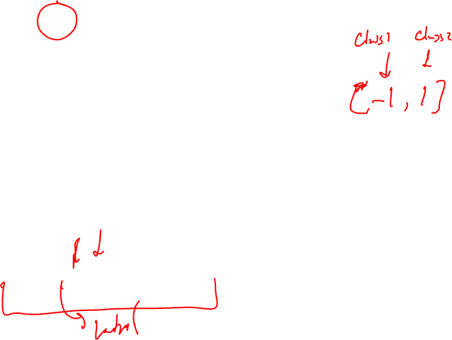
Mathematical formulation*
Source: https://scikit-learn.org/stable/modules/svm.html

Slide 20
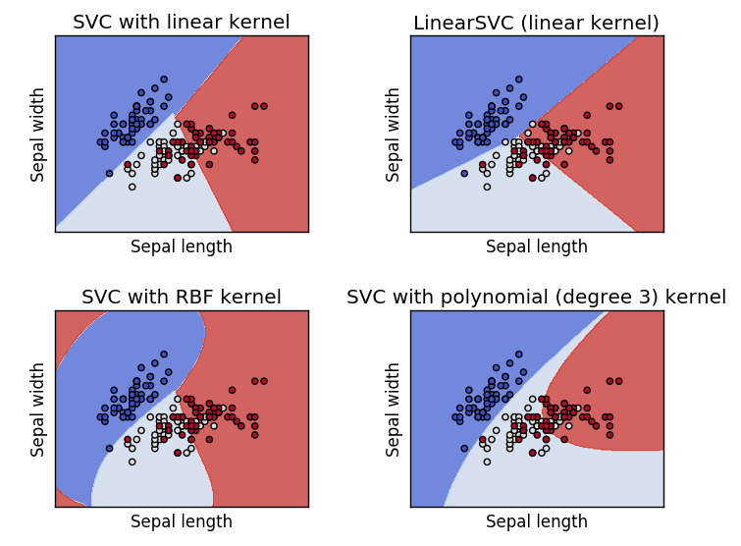
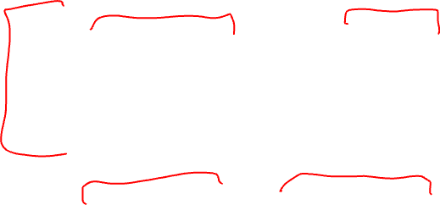
SVM with different kernels
Source: https://vovkos.github.io/doxyrest-showcase/opencv/sphinx_rtd_theme/page_tutorial_introduction_to_svm.html

Slide 21
Decision Trees
A Decision Tree (DT) model is an interpretable model in which a series of comparisons of predictor values against threshold values determines the final output.
DTs are made up of nodes, branches, and leaves.
Each node represents a feature, each branch a choice, and each leaf an outcome.
DTs take a top-down approach to data, attempting to group and classify similar observations and to search for optimal criteria to partition dissimilar observations until they reach a particular level of similarity.

Slide 22
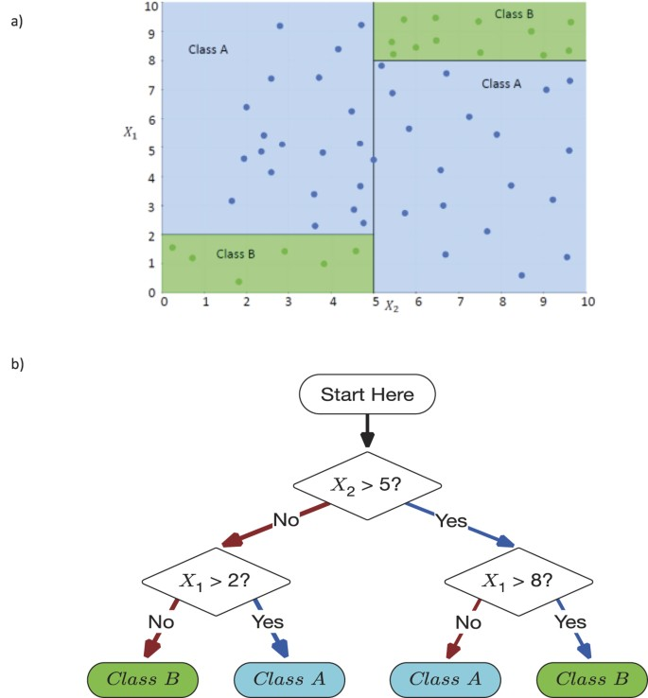
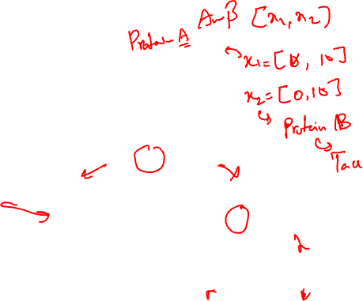
Decision Making Using DTs
Source: Valdes, G., Luna, J., Eaton, E. et al. MediBoost: a Patient Stratification Tool for Interpretable Decision Making in the Era of Precision Medicine. Sci Rep 6, 37854 (2016). https://doi.org/10.1038/srep37854

Slide 23
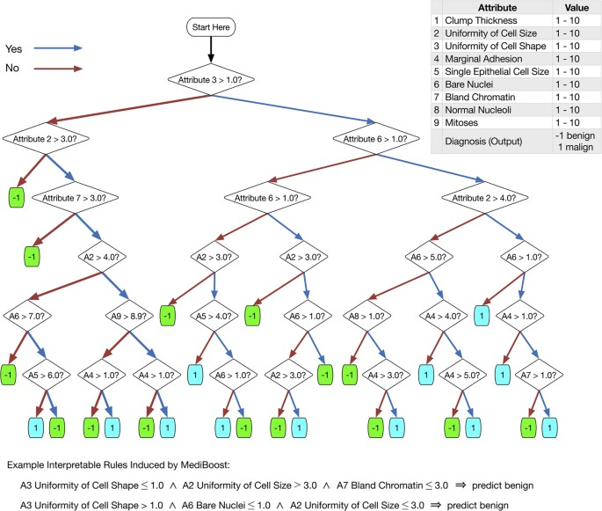
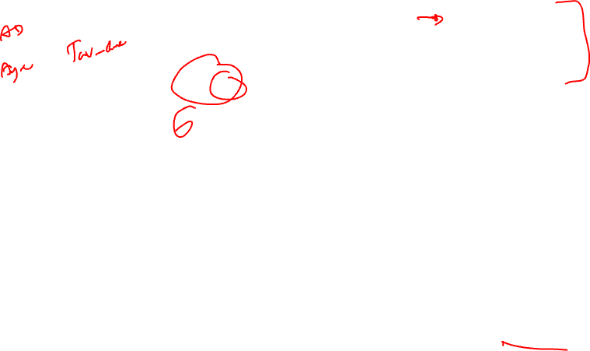
DTs in Clinical Applications
Source: Valdes, G., Luna, J., Eaton, E. et al. MediBoost: a Patient Stratification Tool for Interpretable Decision Making in the Era of Precision Medicine. Sci Rep 6, 37854 (2016). https://doi.org/10.1038/srep37854

Slide 24
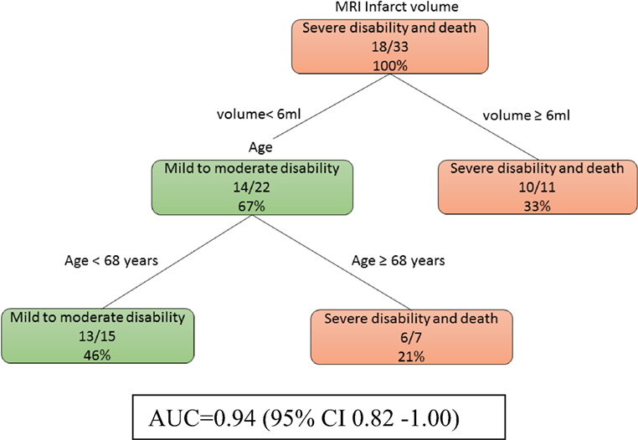
A decision tree model in TBI
Source: Phan, T. G., Chen, J., Singhal, S., Ma, H., Clissold, B. B., Ly, J., & Beare, R. (2018). Exploratory Use of Decision Tree Analysis in Classification of Outcome in Hypoxic–Ischemic Brain Injury. Frontiers in Neurology, 9. https://doi.org/10.3389/fneur.2018.00126

Slide 25
Learning decision trees
Decision Trees (DTs) are a non-parametric supervised learning method used for classification and regression.
The goal is to create a model that predicts the value of a target variable by learning simple decision rules inferred from the data features.
A tree can be seen as a piecewise constant approximation.
Source: https://scikit-learn.org/stable/modules/tree.html

Slide 26
Learning decision trees
There are different algorithms that can be used to learn decision tree structure from the data.
In principle, these algorithms start with a root node in the tree structure, explore the features, and create rules that separate the data one step at a time.
One of the basic algorithms is ID3.

Slide 27
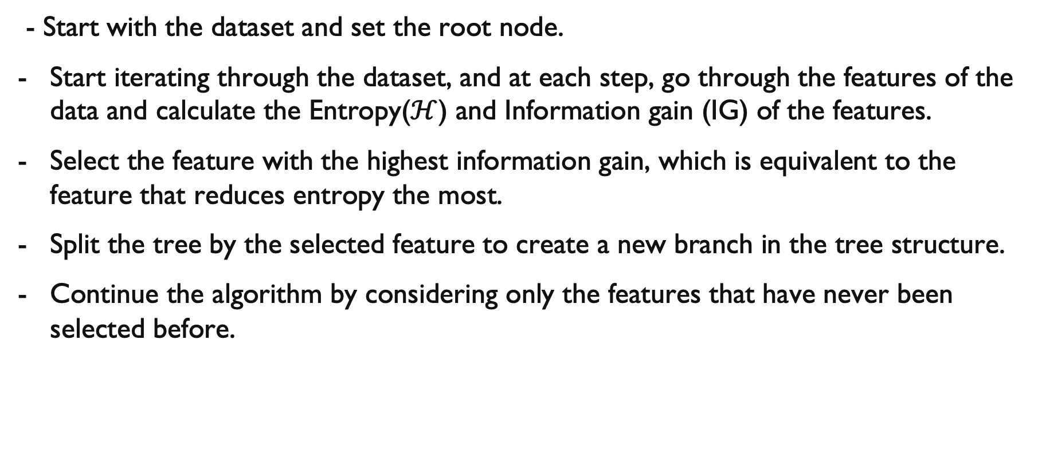
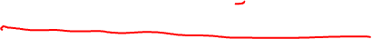
The ID3 algorithms
- Start with the dataset and set the root node.
Start iterating through the dataset, and at each step, go through the features of the data and calculate the Entropy($ℋ$) and Information gain (IG) of the features.
Select the feature with the highest information gain, which is equivalent to the feature that reduces entropy the most.
Split the tree by the selected feature to create a new branch in the tree structure.
Continue the algorithm by considering only the features that have never been selected before.

Slide 28

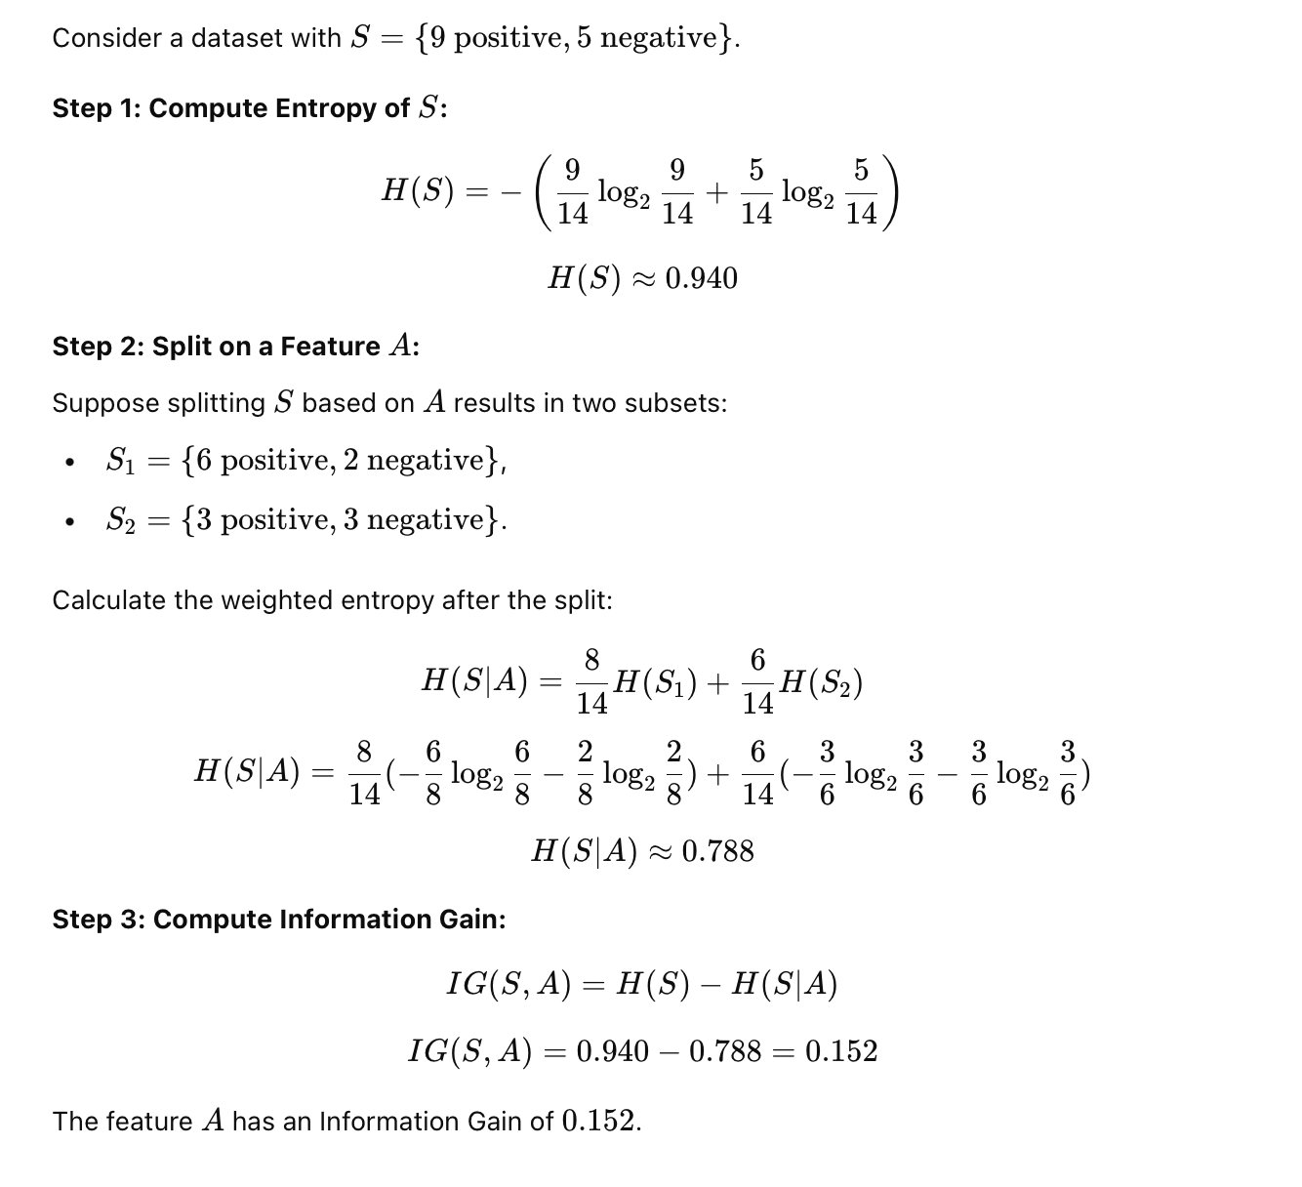
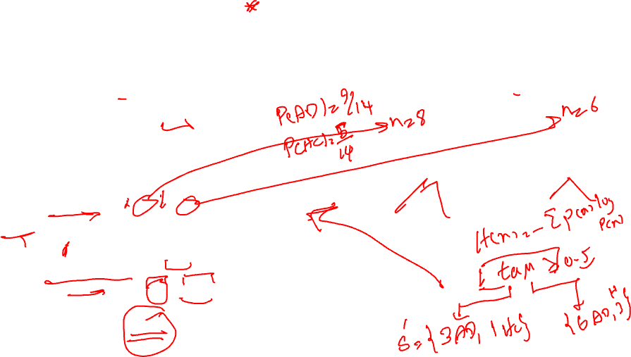
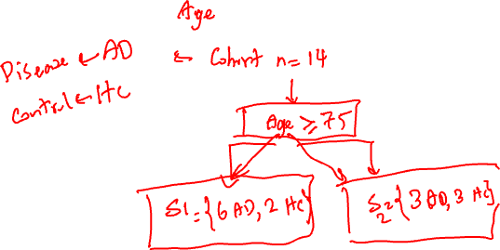
Entropy and Information Gain*

Slide 29
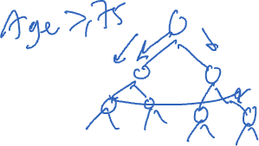
Decision Trees - Limitations
Prone to overfit
Poor generalisation performances
High variance
A slight change in the data can result in a completely different set of splits, which can make interpretation difficult
They can be inherently unstable
The effect of an error in the top splits propagates down to all the splits below due to their hierarchical nature
Produce biased trees for an unbalanced dataset

Slide 30

How to overcome these limitations?
Ensemble:
Single DT is fast but does not perform well
Learn from multiple trees
- We need to be careful not to learn the same tree over and over again.
Bagging:
Bootstrap aggregating, a method that results in low variance
Construct N trees and learn a classifier for each bootstrap sample, and average them
Can improve the accuracy of unstable models that tend to overfit
Feature Randomness:
Feature bagging generates a random subset of features, which ensures low correlation among models

Slide 31
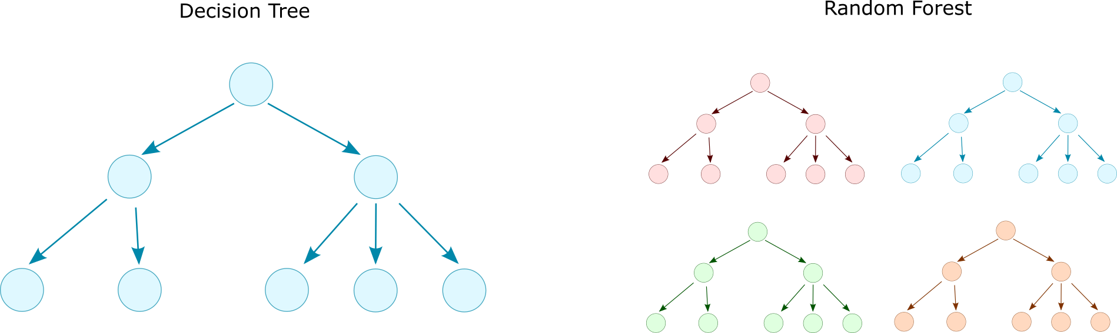
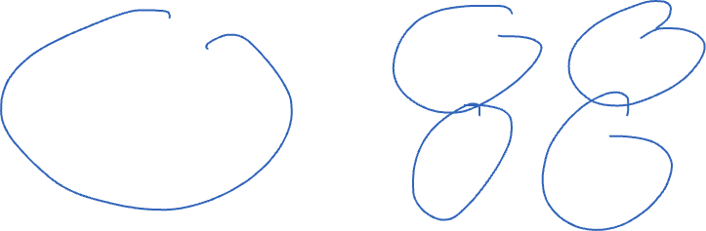
Random Forest
Random Forest was introduced in 2001 to overcome the limitations of decision trees [1].
Ensemble model consisting of multiple decision trees.
Majority vote
[1] Breiman, Leo. "Random forests." Machine learning 45.1 (2001): 5-32.

Slide 32

Ensemble models
Ensemble methods combine the predictions of several base estimators trained with a given learning algorithm to improve generalisability and robustness relative to a single estimator.
Two families of ensemble methods are usually distinguished:
Averaging methods
Boosting methods
Source: https://scikit-learn.org/stable/modules/ensemble.html

Slide 33
Averaging methods
In averaging methods, the driving principle is to build several estimators independently and then average their predictions.
The combined estimator is usually better than any single base estimator because its variance is reduced.
Examples: Bagging methods
Source: https://scikit-learn.org/stable/modules/ensemble.html

Slide 34

Bagging
There are different Bagging methods, but they mostly differ from each other in the way they draw random subsets of the training set:
When random subsets of the dataset are drawn as random subsets of the samples, then this algorithm is known as Pasting.
When samples are drawn with replacement, then the method is known as Bagging.
When random subsets of the dataset are drawn as random subsets of the features, then the method is known as Random Subspaces.
Finally, when base estimators are built on subsets of both samples and features, then the method is known as Random Patches.
In scikit-learn, bagging methods are offered as a unified BaggingClassifier meta-estimator (resp. BaggingRegressor), taking as input a user-specified estimator along with parameters specifying the strategy to draw random subsets.
Source: https://scikit-learn.org/stable/modules/ensemble.html

Slide 35
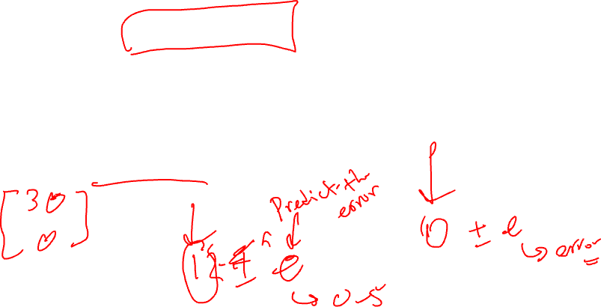
Boosting methods
By contrast, in boosting methods, base estimators are built sequentially, and one tries to reduce the bias of the combined estimator.
The motivation is to combine several weak models to produce a powerful ensemble.
Examples: XGBoost, Gradient Tree Boosting
Source: https://scikit-learn.org/stable/modules/ensemble.html

Slide 36
Gradient Boosting
The term “gradient boosting” comes from the idea of “boosting” or improving a single weak model by combining it with several other weak models to generate a collectively strong model.
Gradient boosting sets targeted outcomes for the next model to minimise errors.
Targeted outcomes for each case are based on the gradient of the error (hence the name gradient boosting) with respect to the prediction.
Source: NVIDIA, https://www.nvidia.com/en-us/glossary/data-science/xgboost/

Slide 37
XGBoost
GBDTs iteratively train an ensemble of shallow decision trees, with each iteration using the residuals from the previous model to fit the next.
The final prediction is a weighted sum of all of the tree predictions. Random forest “bagging” minimises the variance and overfitting, while GBDT “boosting” minimises the bias and underfitting.
With XGBoost, trees are built in parallel instead of sequentially like GBDT.
XGBoost follows a level-wise strategy, scanning across gradient values and using these partial sums to evaluate the quality of splits at every possible split in the training set.
Source: NVIDIA, https://www.nvidia.com/en-us/glossary/data-science/xgboost/

Slide 38
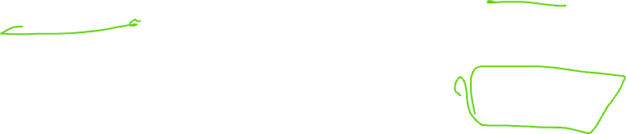
Random Forests
In random forests, each tree in the ensemble is built from a sample drawn with replacement (i.e., a bootstrap sample) from the training set.
When splitting each node during the construction of a tree, the best split is found either from all input features or a random subset of size max_features.
The purpose of these two sources of randomness is to decrease the variance of the forest estimator.
Source: https://scikit-learn.org/stable/modules/ensemble.html

Slide 39
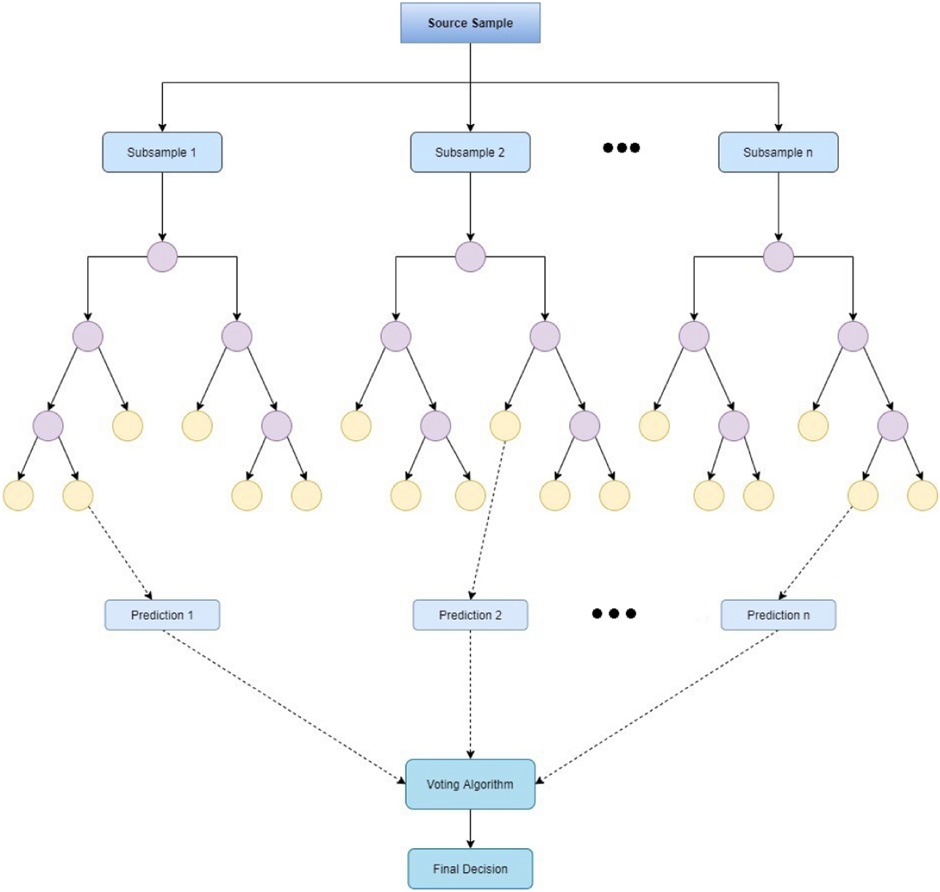
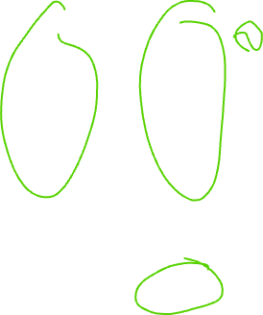
Structure of Random Forests
Source: Malebary, S.J., Khan, Y.D. Evaluating machine learning methodologies for identification of cancer driver genes. Sci Rep 11, 12281 (2021). https://doi.org/10.1038/s41598-021-91656-8

Slide 40
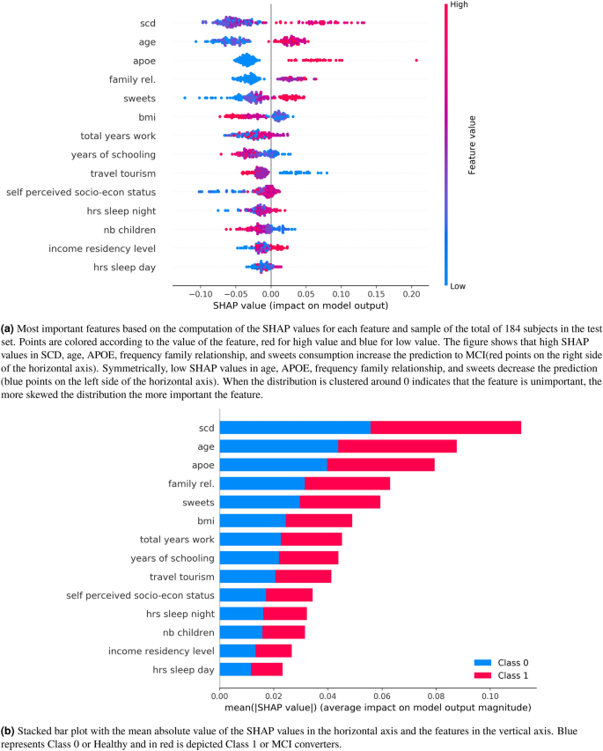
Feature important in RF: Example
Selecting the most important self-assessed features for predicting conversion to mild cognitive impairment with random forest and permutation-based methods:
Gómez-Ramírez, J., et al.(2020), https://doi.org/10.1038/s41598-020-77296-4

Slide 41
Random Forests
Individual decision trees typically exhibit high variance and tend to overfit.
The injected randomness in forests yields decision trees with somewhat decoupled prediction errors.
By averaging those predictions, some errors can cancel each other out. Random forests achieve a reduced variance by combining diverse trees, sometimes at the cost of a slight increase in bias.
Source: https://scikit-learn.org/stable/modules/ensemble.html

Slide 42
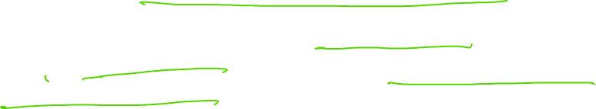
Practical note on RFs
In practice, variance reduction is often significant, yielding a better overall model.
In contrast to the original publication, the scikit-learn implementation combines classifiers by averaging their probabilistic predictions rather than letting each classifier vote for a single class.
Source: https://scikit-learn.org/stable/modules/ensemble.html

Slide 43
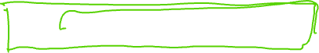
SHAP
SHAP (SHapley Additive exPlanations) is a game theoretic approach to explaining the output of any machine learning model.
It connects optimal credit allocation with local explanations using the classic Shapley values from game theory and their related extensions.
See: https://github.com/slundberg/shap

Slide 44
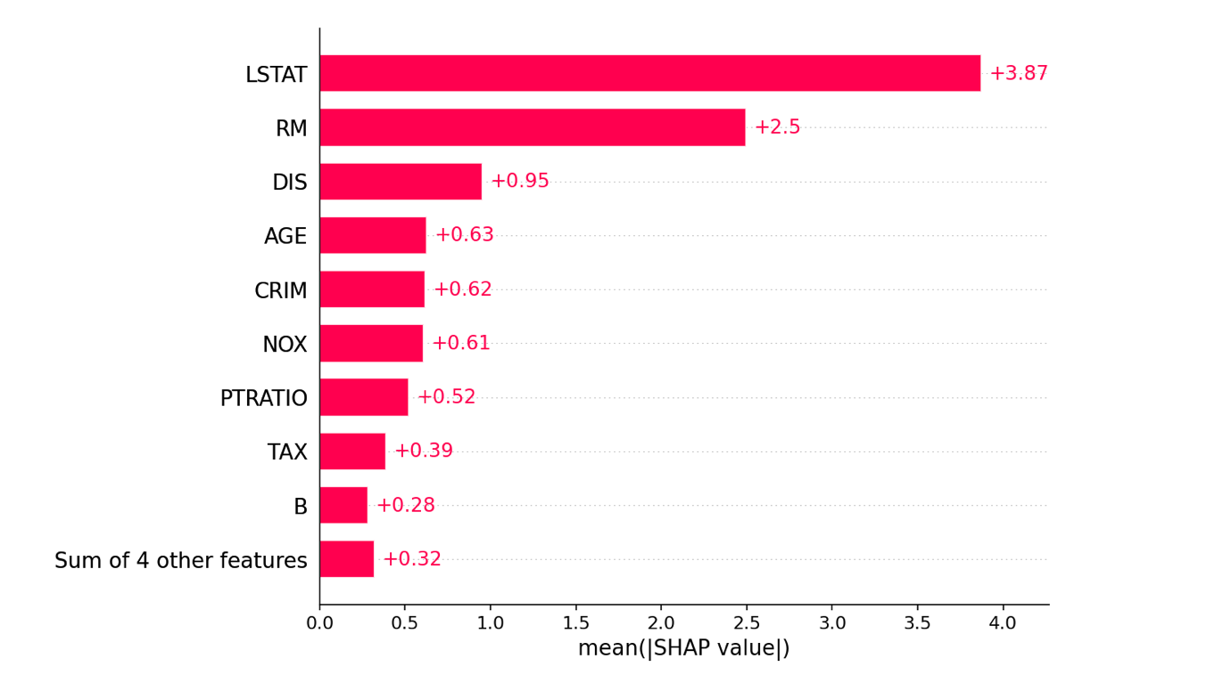

SHAP example 1

Slide 45
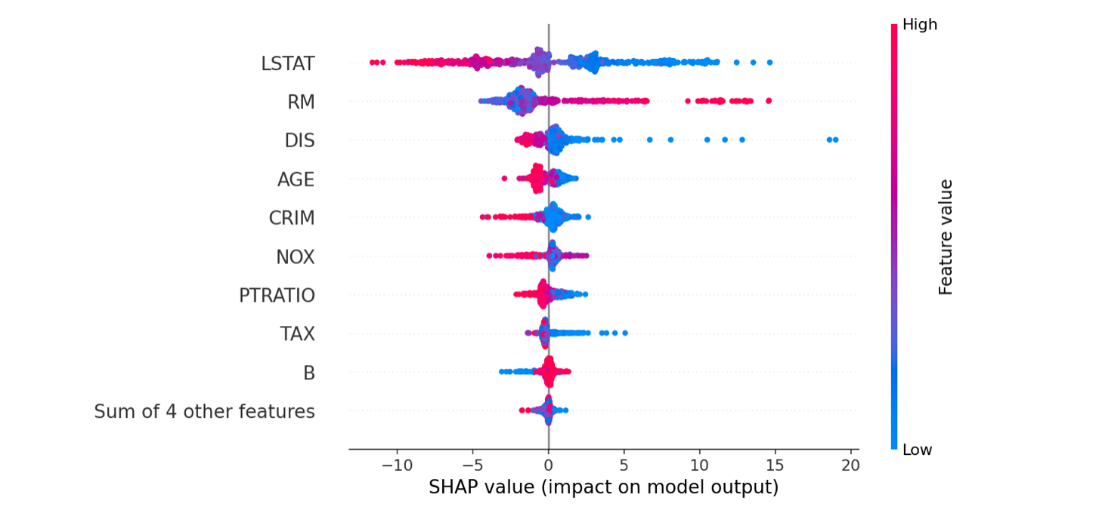

SHAP example 2

Slide 46
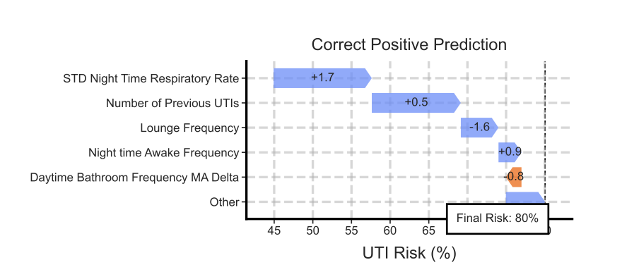
SHAP example 3
Capstick, A., Palermo, F., Zakka, K. et al. Digital remote monitoring for screening and early detection of urinary tract infections. npj Digit. Med. 7, 11 (2024). https://doi.org/10.1038/s41746-023-00995-5

Slide 47
Open discussion
A research team is building a predictive model to estimate the progression of Parkinson’s disease using patient data (motor scores, speech patterns, imaging features).
Ensemble Models:
How could Random Forests or Gradient Boosting improve prediction accuracy compared to a single decision tree?
What trade-offs exist between interpretability and performance in clinical settings?
Kernel-Based Methods:
Could an SVM with an RBF kernel capture non-linear relationships in complex neurological data?
How do we choose between kernel-based methods and ensemble models for this problem?
Ethical & Practical Considerations:
Which approach is more robust to small sample sizes often seen in neurology research?
How do we ensure fairness and avoid bias when using these methods on diverse patient populations?

Slide 48
Review questions

Slide 49
Q1 – RF vs DT
If we have a dataset with multiple features, the samples of which vary, and the different features contribute to the overall class prediction, which of DT or RF would be a good choice?
menti code will be provided.

Slide 50
Q2
In a random forest model, when samples are drawn with replacement, what is the method known?

Slide 51
Q3
In SVM models, there is a hyperparameter known as the Soft Margin of SVM (shown as C in the model implementation). The C hyperparameter introduces a penalty for each misclassified sample.
If you set C to a large value, it will imply a small margin in support vectors. What issue do you think the small margins in support vectors could then cause?

Slide 52
If you have any questions
Please feel free to arrange a meeting or email (p.barnaghi@imperial.ac.uk).
To arrange a meeting, please email my colleague, Ms Rhiannon Kirby.
My office: 928, Sir Michael Uren Research Hub, White City Campus.

Slide 53
